Slide 1
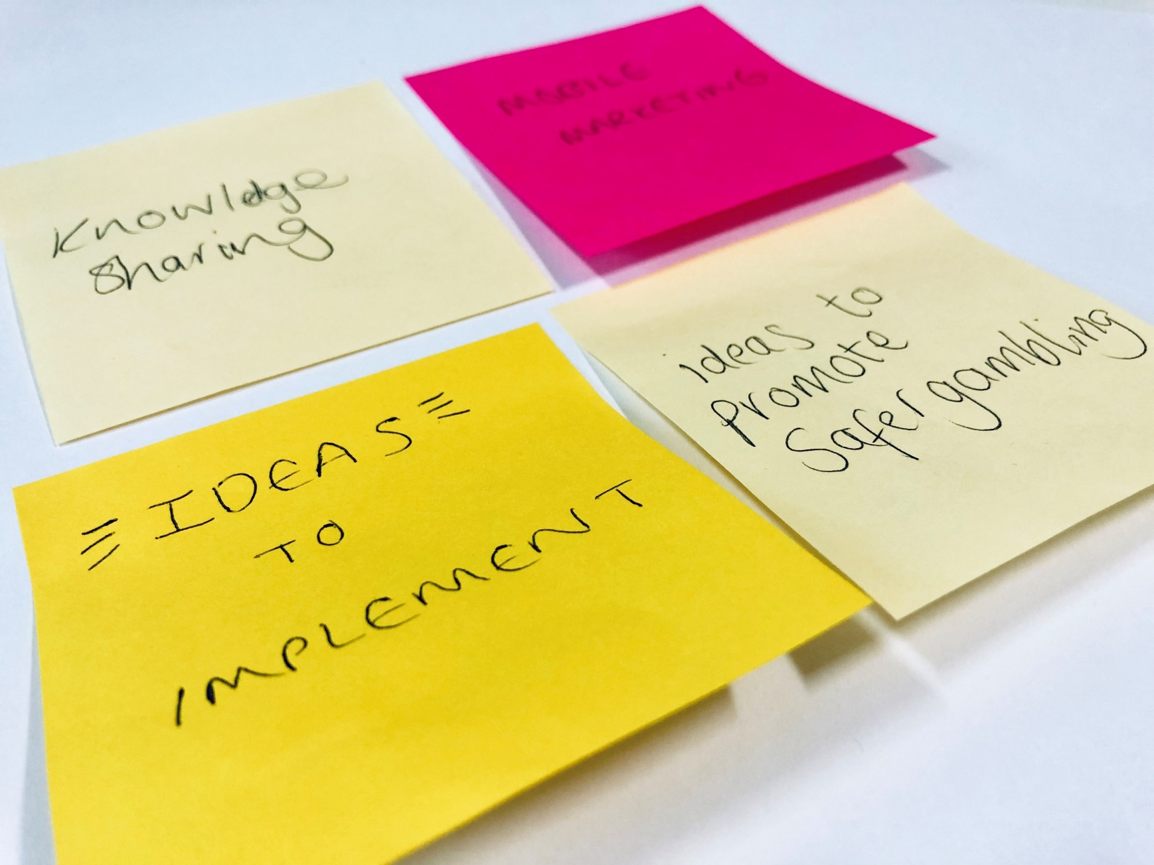
Marketing Co-creation
Workshop
12 September 2019

Slide 2
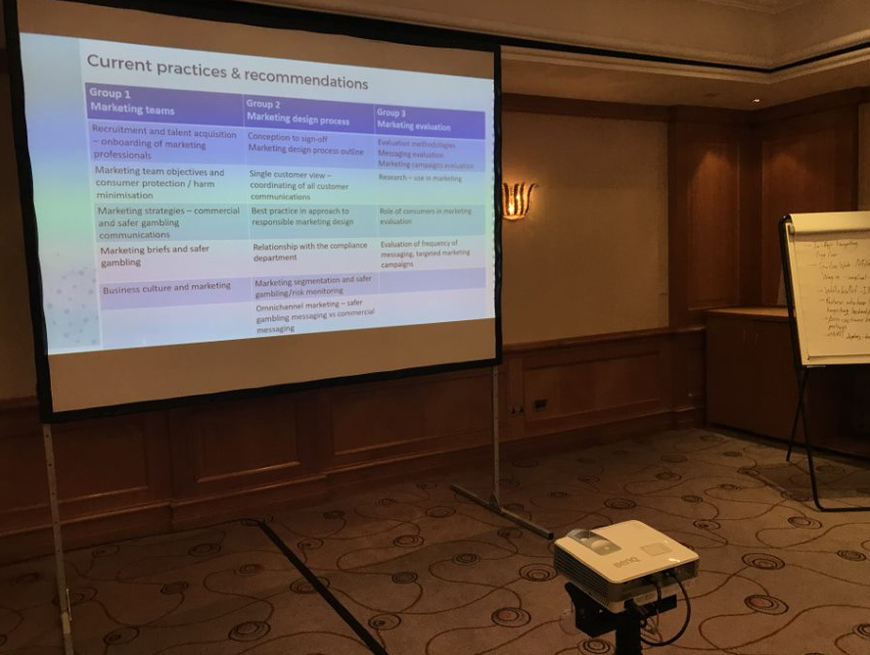
What was the objective?
The workshop provided an opportunity for marketing professionals from a range of gambling businesses to interact.
We wanted attendees to share recommendations and discuss industry challenges and opportunities related to brand, advertising and safer gambling strategies.
There were four sections to the event:
Brand, marketing strategies and safer gambling – Indicia guest speaker
Mobile, accessibility and channel-specific marketing – industry discussions
Marketing research – industry discussions
Marketing processes – industry recommendations
The industry marketing workshop provided an opportunity for marketing business owners to interact, share recommendations related to marketing processes and discuss industry challenges and opportunities related to brand, advertising and safer gambling strategies.
Brand, marketing strategies and safer gambling – guest speaker
Mobile, accessibility and channel-specific marketing – industry discussions
Research and marketing – industry discussions
Marketing processes – industry recommendations

Slide 3
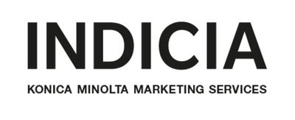
1. Brand, marketing and the safer gambling approach.
Guest speaker: Marketing agency Indicia
Phill Bott Hansson

Slide 4
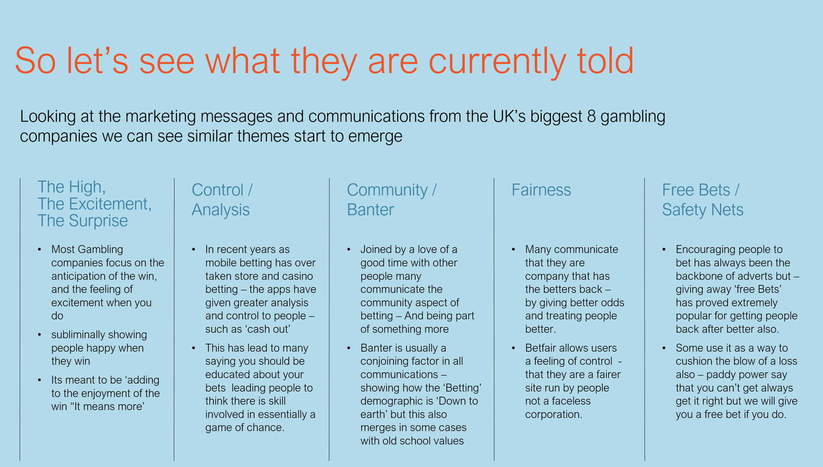
What do customers see?
Indicia: marketing messages from UK’s biggest gambling companies

Slide 5
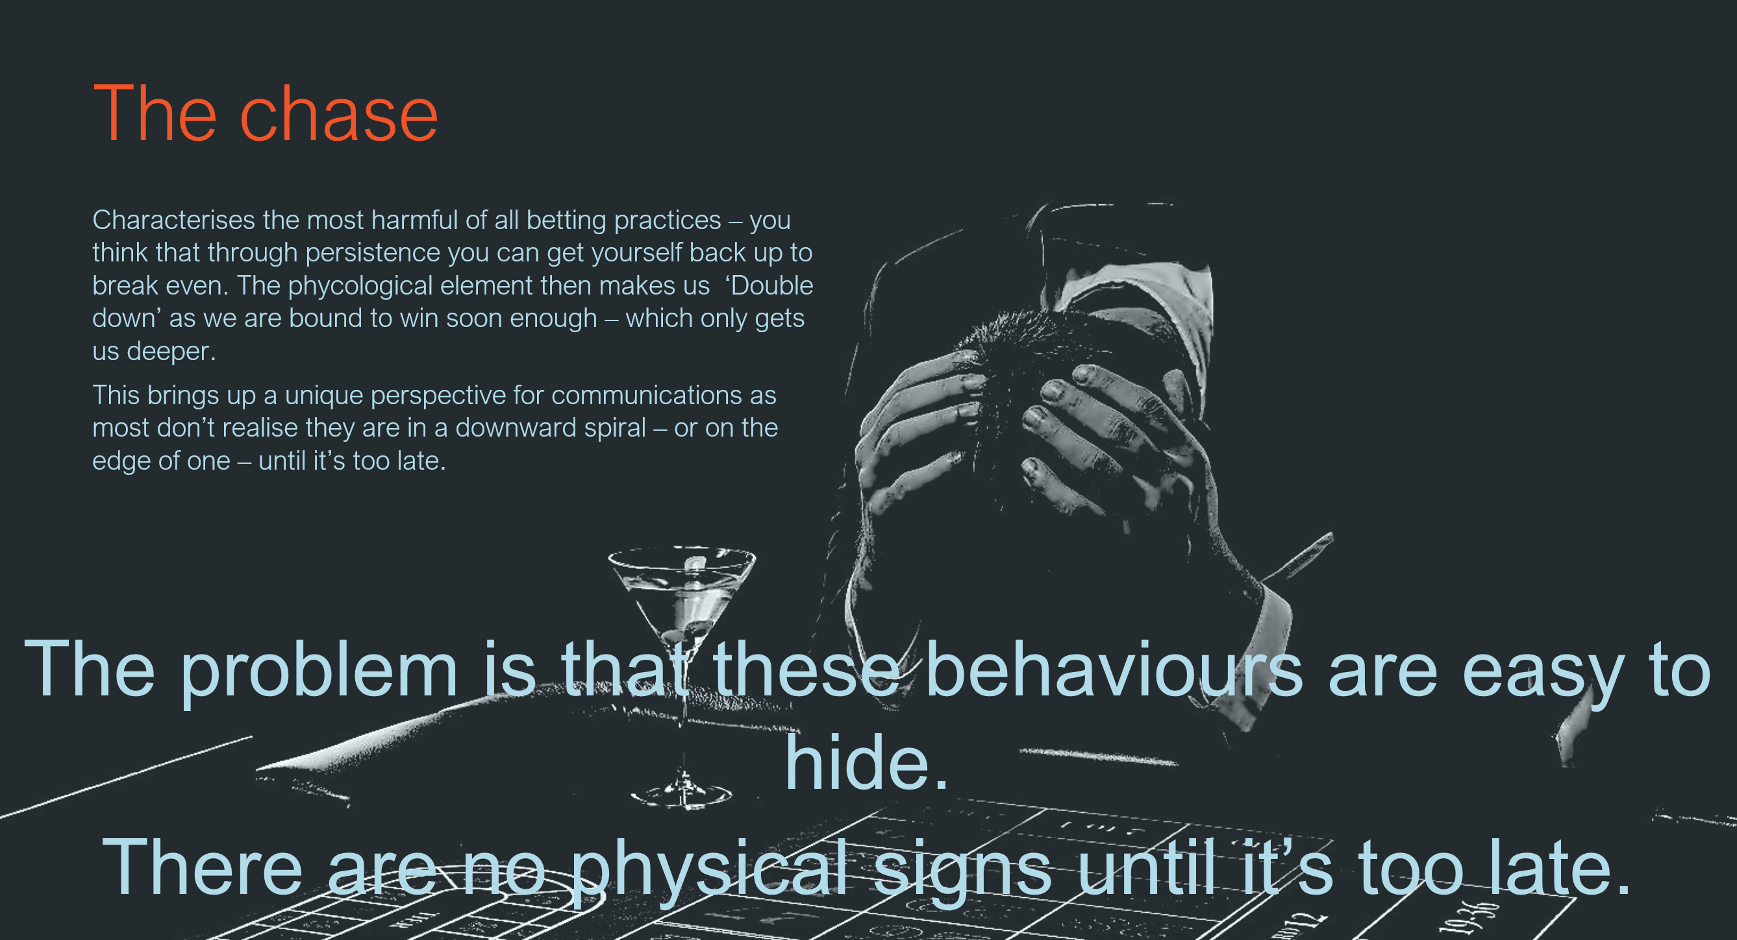
The effects of messaging on behaviour
Rational thought and emotions; short-term effects and long-term effects
Creative approach to impacting social change;
  The power of creating value and authenticity
  Take things to consumers that you might not want to, challenge perception and start a dialogue
If the end goal is to attract customers to gamble responsibly – how can you achieve balance?
The power of brand – how can you attract customers without offers?
Indicia: The dangers of ‘the chase’

Slide 6
Balancing selling and safer gambling
Delegates on: culture and investment
  Marketing is changing and businesses are more receptive to discussions about a responsible gambling focus. Marketing spend is moving to dedicated responsible gambling messaging and long-term effectiveness
  Challenge: Do we have the tools in place to be credible? We need the infrastructure and/or product to back the advert up
  There are differences within our business about the role of safer gambling messages for audiences
  The responsible gambling message doesn’t just have to be acquisition, it can be aimed at existing customers as well. The challenge is around budgets and related target pressures
  Challenge: Is safer gambling part of our permanent brand identity or a short-term campaign?
Delegates on: Creating content for relevant audiences
  Working with a very wide range of products and a variety of sectors makes designing generic but relevant TV ads difficult
  Indicia commented authenticity as key in reaching the Instagram generation to get your message across, especially in a crowded market
  TV is not always the most effective medium. Some campaigns successfully used YouTube pre-roll and chat bots as well as other interactive mediums enabling people to take part in the story. The use of social media is also something which can lend itself to trying new approaches.

Slide 7
2. Mobile, accessibility and channel-specific marketing
Speakers: Gambling Commission’s Insight team

Slide 8
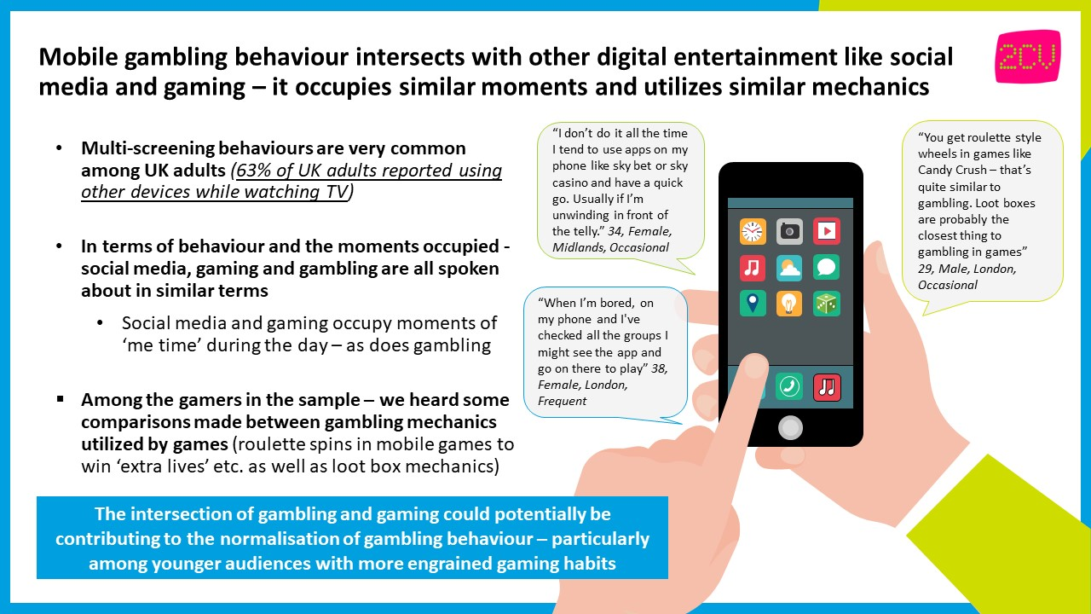

Slide 9
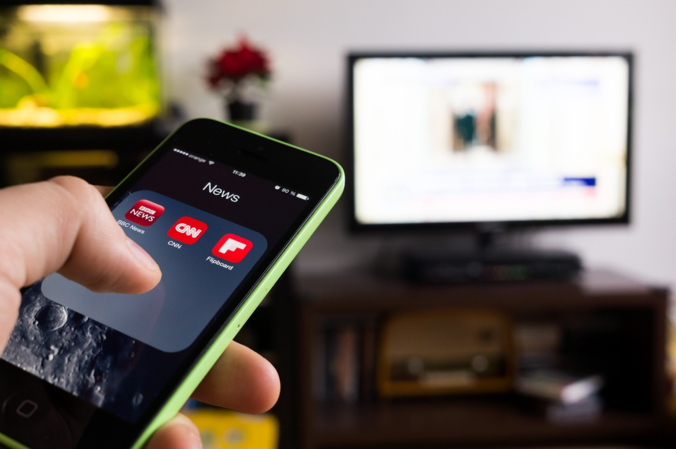
Opportunities of mobile
What are the challenges around ‘multi-screening’ and opportunities of mobile?
Mobile can deliver more personalised messaging. Data can be used to identify and target behaviours, push marketing at relevant times and use geo-targeting. There is potential to utilise the flexibility of mobile to interact better and visualise speed of play.
A single customer view and understanding all of the customer’s activity on different channels and accounts. A full customer view would enable better decision making and a more rounded marketing operation.
The ability to personalise and segment audience. Time of offering can be used to promote responsible gambling messaging.
Instagram launched a feature letting users know they have seen all the new content on their feed. It shows a mid-feed alert confirming ‘You’re All Caught Up’. Perhaps a similar alert system could work in gambling?
Move to Mobile: 63% of UK adults reported using other devices while watching TV
Instagram push notifications can be used to show screen time and amount spent. Well-timed push notifications can be used to identify if a customer is getting into a difficult position.

Slide 10
3. Marketing research and the impact on your business
Speakers: Gambling Commission’s Insight team

Slide 11
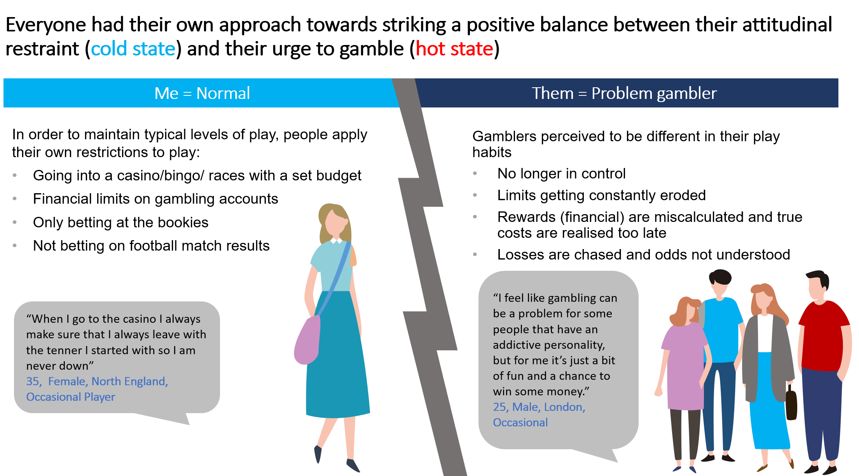
Consumer research: communications
Before the session we shared our consumer research with delegates. This was produced working with research company 2CV. You can read the research on our website. We asked delegates to discuss three key areas from the research:
1. Communications – how can we consider ‘hot’ and ‘cold’ gambling states identified from the research?
Use existing tools – exploring the use of existing limits and tools and focus on highlighting the positive impact they can have e.g. lottery subscription limits
Placement and focus – looking into current strategies designed to follow-up and encouraging repeat play on the back of sports betting in-play triggers - campaigns encouraging lower pay outs and early withdrawals
Trust – consideration of not upselling to already converted buyers and creating promotions which enable buyers trust in the providers. Mutual trust campaigns which focus on trusting the buyer to know their limits and approaching this from a different angle.

Slide 12
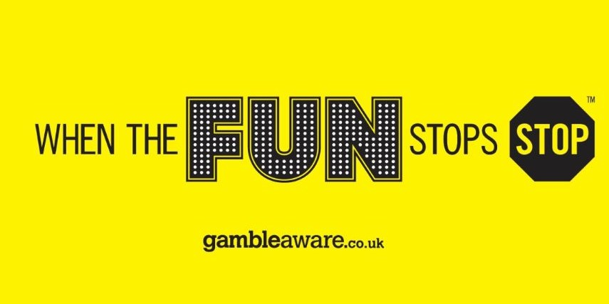
Consumer research: cynicism
Before the session we shared our consumer research with delegates. This was produced working with research company 2CV. You can read the research on our website. We asked delegates to discuss three key areas from the research:
2. Cynicism – Do you agree, if the aim of advertising is to always generate MORE play, responsible play messages from industry are experienced cynically and perceived as ineffective?
Consistency – of the communications and customer education has the potential to impact cynicism associated with distrust towards the game fairness or superstitious approach towards gambling
Timing – commercial activities like game launches should be carefully planned in consideration of responsible gambling to ensure a consistent message to audiences
Acquisition vs sustainability – is the aim of advertising always to generate more play?
  Acquisition campaigns are being gradually replaced with strategies focusing on sustaining existing players
  Acquisition messaging doesn’t have to sit separately from responsible gambling messaging for people to see you as a brand
Customer journey – focus around journey for new players; ‘what do I see on site?’ ‘How am I guided through tools?’

Slide 13


Consumer research: normalisation
Before the session we shared our consumer research with delegates. This was produced working with research company 2CV. You can read the research on our website. We asked delegates to discuss three key areas from the research:
3. Normalisation of gambling – what is the impact on advertising?
• Public perception – some gambling events, for example Grand National, are family events and part of British culture. Certain aspects of gambling like sweepstakes, or cutting out paper horses, might not be considered as gambling.
• Gambling personas – used to be more prominent in adverts, focusing on young men at social occasions and celebrating the ‘macho’ nature of gambling. Recent Advertising Standards Authority rulings and marketing changes are gradually changing approaches.
• Gaming – is now also a strong focus. Loot boxes are perceived as advertising gambling to children, with the potential to impact their future gambling behaviour.
Family
Friends
“Being introduced to gambling through friends and family normalises the behaviour – creating the sense that ‘everyone does this.” – 2CV research

Slide 14
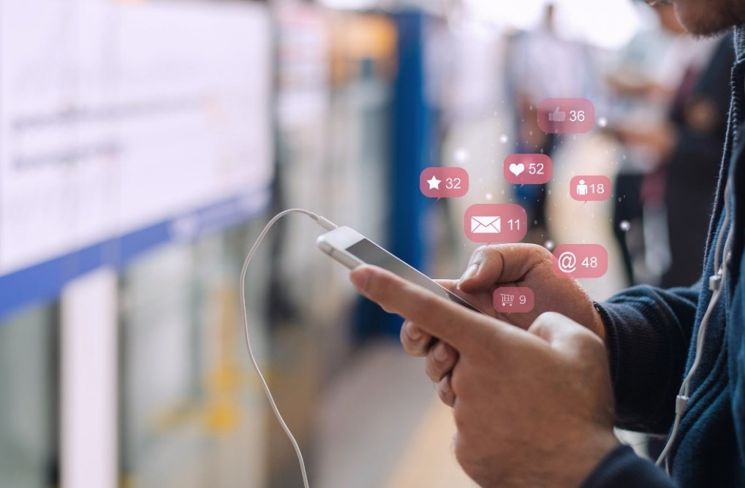
GambleAware research
GambleAware published an interim report produced by Ipsos MORI. The report examines the frequency and format of gambling advertising and exposure to children, young people and vulnerable adults.
We shared the following recommendations from the report for the gambling, advertising and technology industries:
Explore making better use of technology to minimise the risk of exposure of gambling advertising content to children, young people and vulnerable adults ​
Using advertising technology to positively exclude certain online profiles from seeing gambling ads (including those with child-like persona and those who have sought help for problem gambling) and working with platforms such as Twitter to make use of features that allow better age verification for account followers ​
Integrate more explicit and more frequent references to risk and responsible gambling within advertising and consider the visibility of warnings within advertising content
The research was carried out by two consortia led by Ipsos MORI and the Institute for Social Marketing at the University of Stirling.
Notes:
Add picture (right hand side)

Slide 15
4. Marketing processes – industry recommendations
Co-created by delegates at the event.

Slide 16
Marketing Teams
Recruitment
It is challenging to recruit candidates with a regulation mindset, the pool of experienced gambling marketeers is limited. Brand reputation can help attract stronger candidates. Communicate your values and objectives linked with regulation and social responsibility – make sure your brand promotes itself.
Listening to customers and contact centre calls provides invaluable insight into your audience. Consider specific training relating to compliance, marketing guidelines and gambling harms (problem gambling) as part of induction.
Should be consistent across the business, product design, data and other departments involved in marketing campaigns. Consider tying RG metrics with financial KPIs and incorporate appropriate reporting to monitor both.
Buy-in at senior level, buy-in from your CEO is key. Is safer gambling part of your business objectives? Consider internal communications and linking business strategies with safer
gambling objectives – disseminate that message across the business.
Onboarding
Team objectives
Culture

Slide 17
Design process
Ownership
Incorporate marketing compliance consideration into the design process from the start. Ensure your team members understand their individual responsibilities in relation to marketing compliance.
Don’t treat it like a tick box exercise. Aim to integrate marketing compliance with marketing. Consider having a marketing compliance owner within your department and how to involve compliance throughout the design process.
Work with your teams and have a consistent approach to marketing to individuals who return to gambling after a period of self-exclusion as well as towards customers who are under risk reviews on the back of their activity indicating potential risk of harm.
Timing commercial activities like game launches should be carefully planned in consideration of responsible gambling and sending a consistent message to audiences. Establish ethical principles with third parties and bring them on board.
Compliance
Single customer view
Investment

Slide 18
Evaluation
Of training
Your team members should understand the compliance elements of their roles, work in line with your safer gambling strategy and constantly go through online training to be up to speed.
Responsible gambling and evaluation need to be integrated. Incorporate evaluation in marketing processes, alongside commercial evaluation. How could you approach evaluating marketing elements?
Coordinate your activity with compliance to understand product innovation, associated risks and work together on marketing solutions fit for the current regulatory landscape.
Share learnings from current practice and take part in collaborative projects which can benefit your own business and other companies.
Responsible gambling
Innovation
Practice sharing forums

Slide 19

Feedback from the day
“We all face similar challenges; no-one has best practice. Test and learn and share.”
Sharing platform – providing the opportunity to understanding other operator’s methodologies and processes
Collaboration – enabling tackling shared challenges, even if only in the form of discussions to begin with. Opportunity to work together, demonstrate progress made and change perceptions
Learning – from each other
Relationship – with the regulator and open two-way discussions - feeling included
New perspective – helpful including of an external agency, more hands-on solutions and case studies would be beneficial, more focus on scenarios.

Slide 20
Next steps
We are planning a follow-up event with marketing professionals. If you would like to get involved in next steps, including industry collaboration, please contact: cocreation@gamblingcommission.gov.uk
Relevant research discussed during this event can be found here:
2CV research – How gambling fits into people’s lives:
https://www.gamblingcommission.gov.uk/news-action-and-statistics/News/blog-how-gambling-fits-into-peoples-lives
Links to other workshops and relevant reading can be found here:
Customer Interaction – Safer gambling messaging https://www.gamblingcommission.gov.uk/news-action-and-statistics/News/co-creation-workshops-safer-gambling
Evaluation – https://www.gamblingcommission.gov.uk/news-action-and-statistics/News/blog-industry-co-creation-workshop-evaluation-of-safer-gambling-products-and-processes
Notes:
Image here

Slide 21
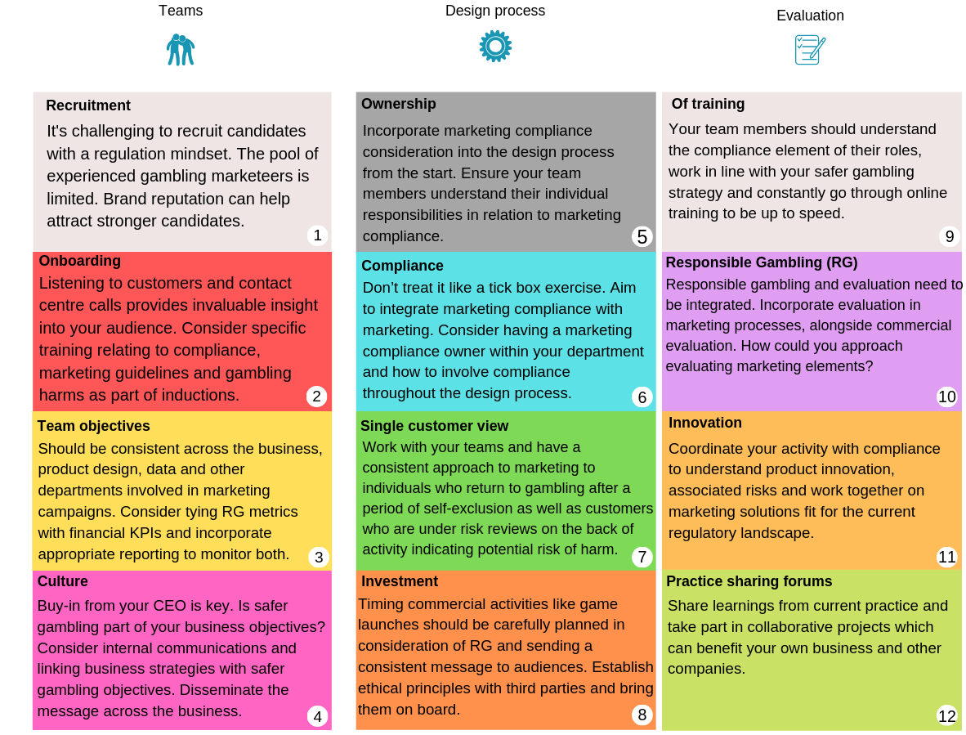
Industry recommendations
Notes:
Try logo

